Slide 1
Training: Software Enginering
Mr Benabderrezak
PHD Student & Future Pr

Slide 2
01
02
TABLE OF CONTENTS
03
04
Algorithms, Data Structures, Clean code
Linux , Git , Github
Web developement
PRACTICAL LEARNING

Slide 3
WHOA!
I’m Benabderrezak Youcef
PHD student in cyber security (Future Pr)
Master in Information Technology Engineering.
Special skills in conception, analysis and passionate about
project management

Slide 4
01
Algorithms, Data Structures, Clean code

Slide 5
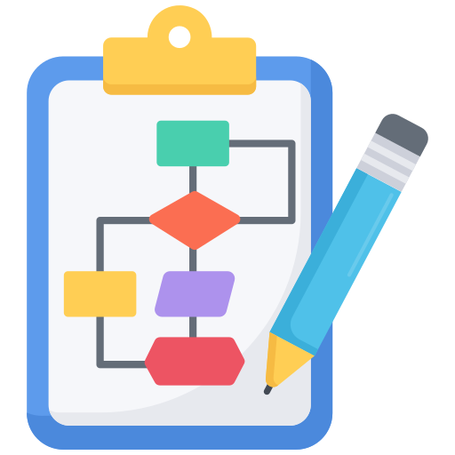
Algorithms ?
Algorithms refer to a set of steps or procedures that are used to
1. solve a problem
2. perform a task

Slide 6
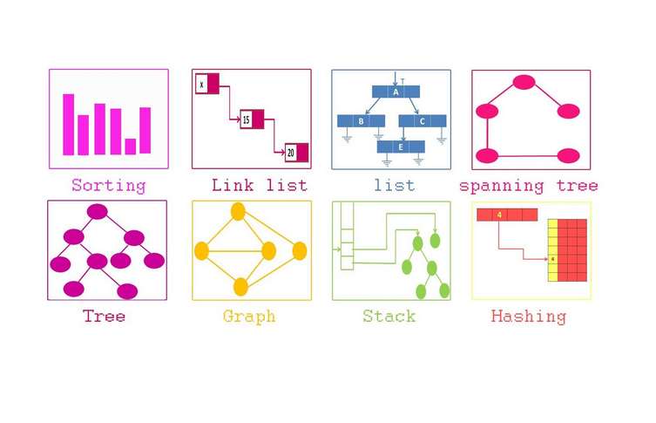
Data structures ?
Data structures are ways of organizing and storing data in a computer
so that it can be accessed and used efficiently

Slide 7
Clean code ?
Clean code refers to well-organized, readable, and maintainable code that is easy to understand and modify.
All 3 concepts are important for developing efficient, maintainable, and scalable software applications

Slide 8
Linux
Linux is an open-source operating system
which means that the source code is freely available to anyone who wants to use, modify, or distribute it
Linux is also known for its stability, security, and flexibility

Slide 9

Git
Git is a distributed version control system for software development
With Git, developers can :
track changes to their code over time
Collaborate with other developers
Manage different versions of their codebase

Slide 10

Github
GitHub is a web-based platform that provides a range of features and
tools for software development and collaboration
GitHub allows developers to :
host their Git repositories on the platform
making it easy for them to collaborate with others
share their code with the wider community
create and manage repositories, contribute to other people's repositories
track issues and bugs using GitHub's issue tracking system.

Slide 11
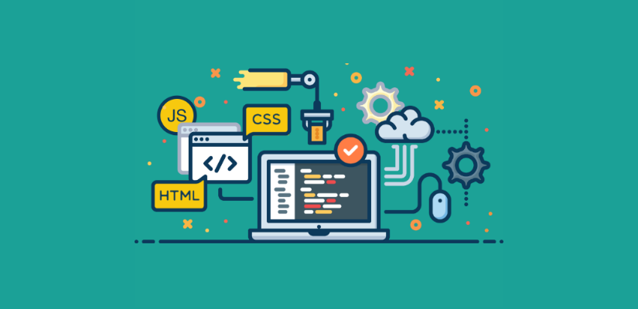
Web developement
Web development refers to the process of creating websites and web applications that can be accessed over the internet.
It involves a range of skills and technologies, including :
web design
web programming
web content creation
web server administration

Slide 12


